Slide 1

TECH LAYOFFS ANALYSIS

Slide 2





INTRODUCTION
DATA DESCRIPTION
ANALYSIS
INSIGHTS
CONCLUSION
AGENDA

Slide 3
INTRODUCTION
The IT sector is renowned for its explosive growth and innovation, but it is not exempt from recessions and job losses.
The IT industry has seen waves of personnel reductions in recent years as a result of mergers and acquisitions, shifting market circumstances, and other causes.
The tech layoffs dataset offers a thorough record of layoffs in the IT industry through time from different organizations and industries.
This information may be used to look at layoff trends, identify the businesses or sectors that have the most layoffs, and look into the causes of these trends.

Slide 4
DATA DESCRIPTION
The tech layoffs dataset is a compilation of information on layoffs that have place over a specific time period in the technology sector.
The dataset contains details on the organization, sector, number of layoffs, head office, reported date, and status for each occurrence.
The following columns are used to arrange the data:
-Company: Name of the organization where the layoffs took place.
-Sector: The sector in which the business works.
-Year: The year that the layoffs took place.
-Total layoffs: The number of employees that were let go as a result of the situation.
-IPO Status: Whether the organization is private or public.

Slide 5
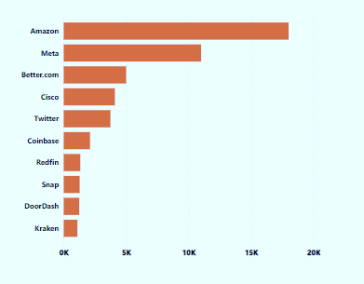
DEEP DIVE INTO ANALYSIS
Companies with the highest number of layoffs:

Slide 6
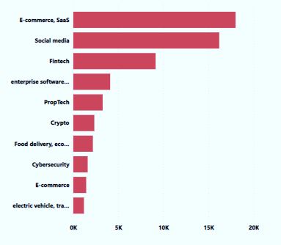
Industries with the highest number of layoffs:

Slide 7
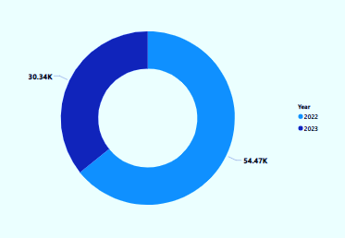
Trend in the number of layoffs over time:

Slide 8
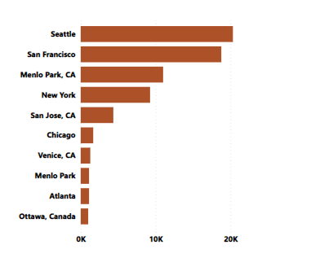
Layoffs by Headquarters Location:

Slide 9
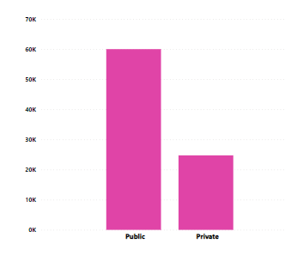
Type of companies with the highest number of layoffs:

Slide 10
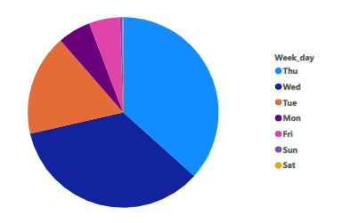
Weekdays with the highest number of layoffs:

Slide 11
INSIGHTS
The businesses that have seen the most layoffs include Amazon, Meta, and Better.com. This might be a sign that these businesses have been going through financial difficulties or restructuring initiatives .
The SaaS and e-commerce sectors appear to have had the greatest layoffs, followed by the finance and social media sectors. Layoffs in these sectors, which have seen tremendous growth in recent years, might signal a market shift or a change in corporate strategy .
In 2022, there were more layoffs, and it appeared that public firms had more layoffs. This may indicate that public corporations are under more pressure to increase profitability and reduce expenses.
On Thursdays, Wednesdays, and Tuesdays, layoffs were more frequent. To minimize interruption to the workweek, it's likely that businesses prefer to announce layoffs in the middle of the week.
Seattle, San Francisco, and Menlo Park, CA headquarters had more layoffs than other sites. This could be the case since more tech businesses are headquartered in these areas because they are centers for innovation and technology.

Slide 12
CONCLUSIONS
The rise in layoffs in the IT sector implies that businesses are facing serious difficulties that might be caused by changes in the economy or internal restructuring initiatives .
Layoffs are a typical occurrence in business and do not always portend long-term issues for the organizations involved ,despite the fact that certain industries have been more affected than others .
It will be fascinating to monitor how businesses react to shifting market conditions as the digital sector develops and if further layoffs will be required in the future .
While e-commerce saw the biggest layoffs, the artificial intelligence sector experienced one of the lowest. According to my study, I believe that new technologies are rendering older ones obsolete , which lessens the demand for particular skill sets .

